Slide 1

Generative AI for the Python Developers
(James) Kanin Kearpimy
Microsoft MVP (Python and Developer Technology)

Slide 2

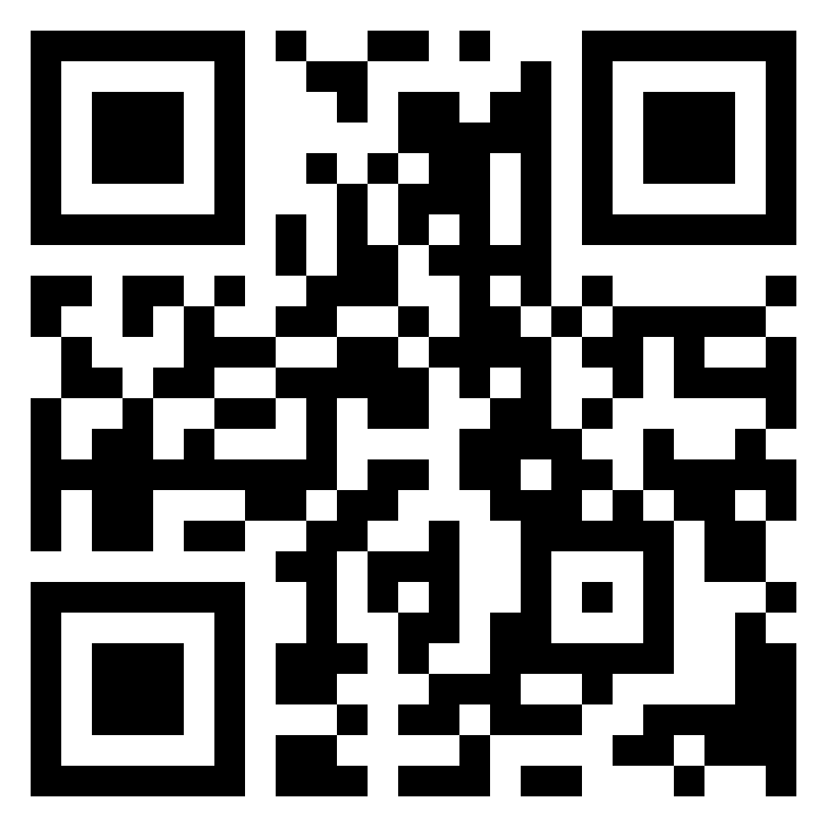
Nice to meet you
You can call me James.
I love Python, Low-level stuff like Compiler
Last year, I ran PyCon Thailand 2023.
Beside Microsoft MVP, I’m currently MongoDB Community Leader
Talk more with me here

Slide 3
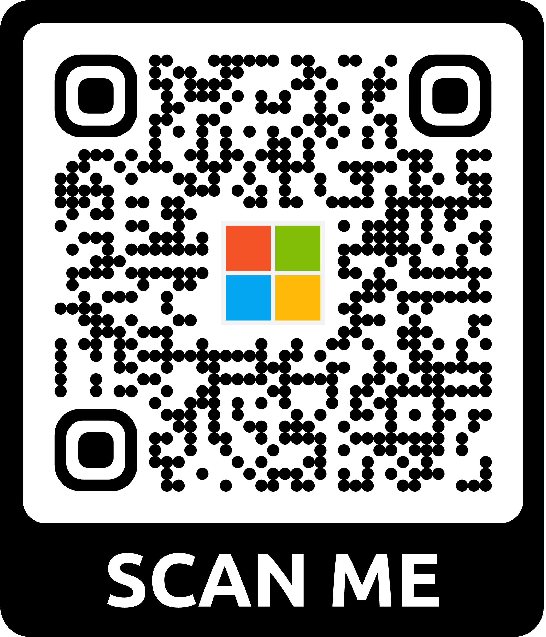
Check form!!!
Microsoft wants to hear from YOU!
Attendee Survey
Season of AI | Microsoft Community
aka.ms/AttendeeSurveySeasonOfAI
2024
Notes:
Remind attendees to participate in the event survey

Slide 4
Demo
Notes:
Let’s start with a demo of what we can do with Azure OpenAI Service by having a “search your own data” (RAG pattern) application. We’ll use https://github.com/Azure-Samples/YouTubeGPT as the sample application for this.
Demo Script
Open the application in VS or VS Code
Navigate to the frontend Aspire resource
Enter a prompt that will match some useful results (eg: I want to learn AI and .NET)
Presenter note – be sure you’ve loaded the postgres index beforehand and it’s probably a good idea to have launched it already in VS to reduce load time.

Slide 5
Generative AI
Notes:
Well, that demo had a lot of moving parts in it, let’s break it down into a few smaller pieces to learn just how it did what it did.
Underpinning all of it though was Generative AI, so before we go into the .NET aspect of it, let’s have a look at just how Generative AI works.

Slide 6


Large Language Models (LLMs)
“Once upon a time,
GPT 3.5
GPT 4
“In a quaint village nestled between rolling hills and meandering streams, there existed […]. ”
N-token Prompt
M-token Completion
Notes:
First, let’s define a Large Language Model, commonly abbreviated as LLMs. LLMs are a type of generative AI model that can generate and understand natural language by learning statistical patterns of natural language from huge volumes of text – books, articles, web pages, and social media - basically anything that is text.
An LLM works by estimating the probability of a word, or token or a sequence of tokens, given some previous tokens or context. They can also generate whole sequences of tokens, such as a paragraph or a story through an expanding window pattern.
LLMs repeatedly predict the next token using context and its prior predictions until a stop condition is met.
Phrased another way, you can think of these models as being training on a large chunk of the Internet, so their parameters represent something like a 100x compression of all the knowledge contained on the Internet into a ~140GB file. By optimizing the model on the next-word prediction task as part of self-supervised training loop – meaning hiding parts of input text and asking the model to predict the missing parts - the model learns about the world just to predict that next word.
[Ready the audience/vibe: joke] Learning about the world just to predict the next word in a sentence sounds like a lot of work, right?
You interact with these models by inputting a prompt, which is a series of words or tokens. LLMs make predictions based on your prompt and output a completion, which is a series of words or tokens again.

Slide 7
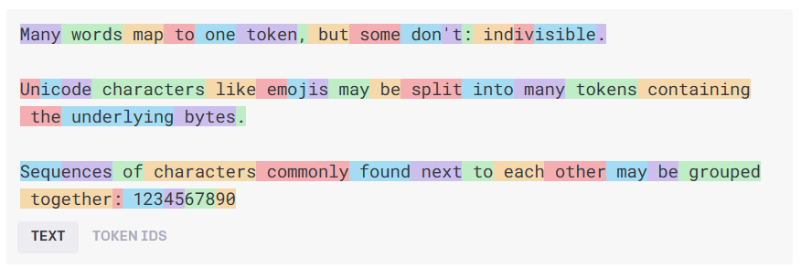
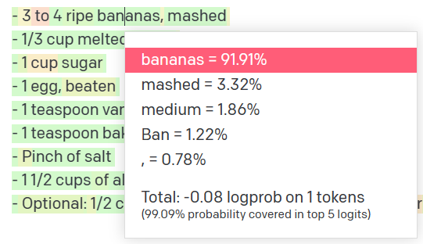
How language models work
Natural language input
Pre-processing
Tokens
Natural language output
Model
Get results
Decoding + Post-processing
Probability distribution
Notes:
The language model receives raw text, then tokenizes the text, tokens are chunks of text depicted by the different colored boxes in the image above, and these tokens are then transformed into integers that are fed to the model.
The model is a transformer architecture-based neural network, which we don’t have time to dive into here, but essentially the goal of this model is to predict the next word in a sequence, which leads to the model sampling a probability distribution that results in the final text/token output.
General idea:
Text -> token
Token (are numbers) Numbers go into the model
Model samples a probability distribution, then outputs natural language (a single token)

Slide 8
How language models work
n tokens in
1 tokens out
Notes:
The simplified idea is….
N tokens in
1 token out

Slide 9
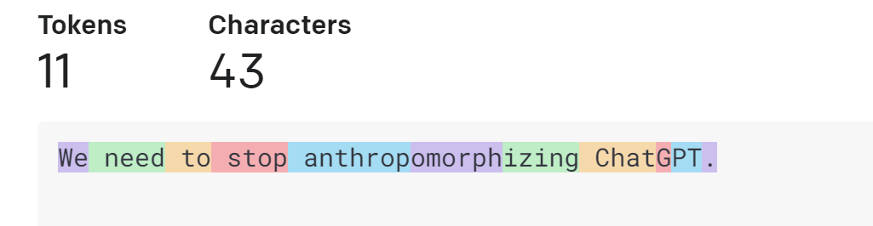
How language models work
Tokens
https://platform.openai.com/tokenizer
Notes:
To clarify on what a token is….
A token is not a letter
Or a word
In case of openAI
A token is a short sequence of letters
For example a token can be “we”, “of”, “need” => because they are short and commonly used But a token can also be part of a word like anthropromorphisized takes 3 tokens, because it is a long word and not commonly used
This is how the tokenizer in OpenAI works

Slide 10
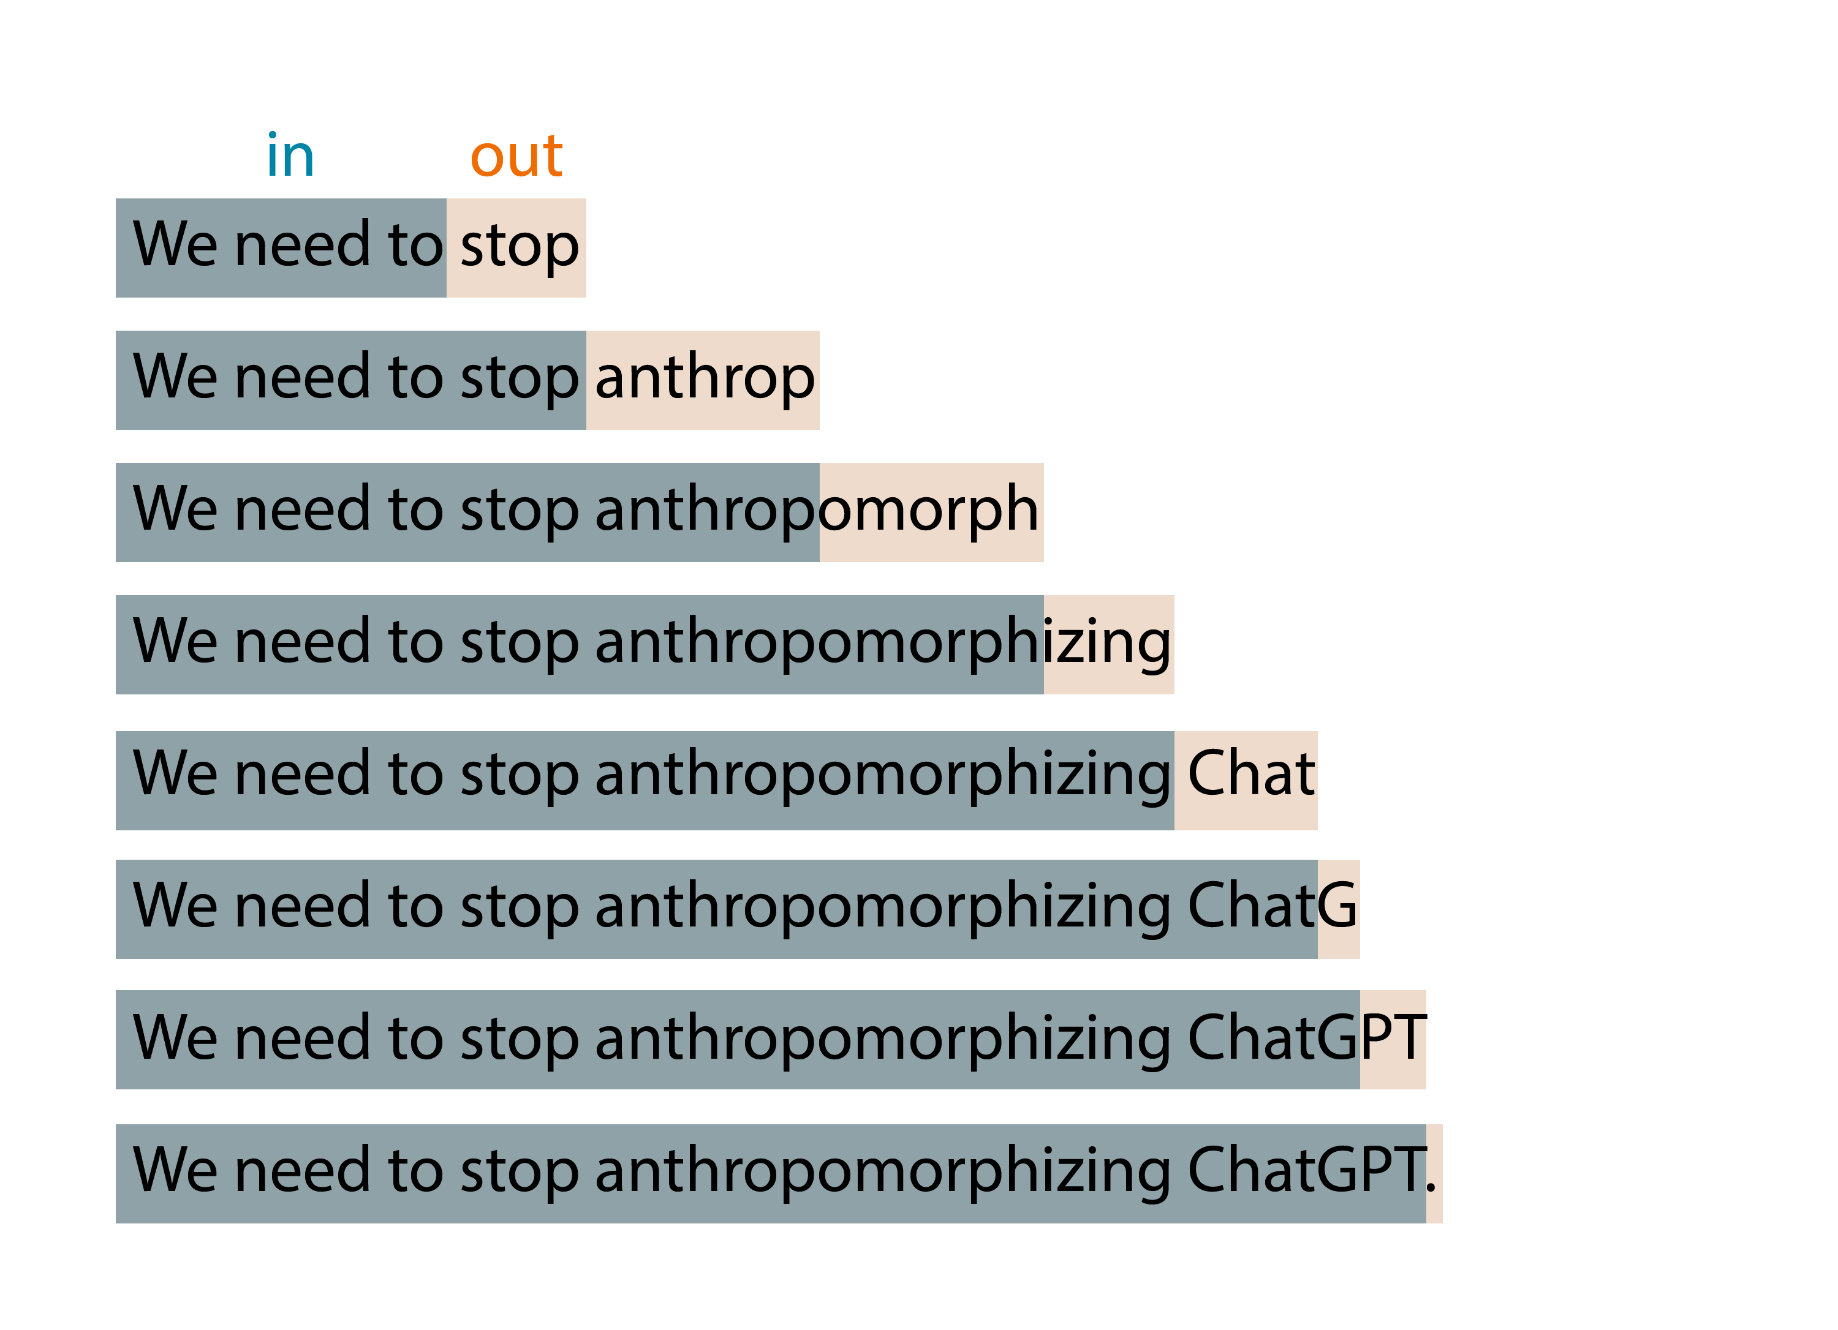
How language models work
Notes:
That’s because this basic idea is applied in an expanding-window pattern.
You give it tokens in, it produces one token out,
then it incorporates that output token as part of the input of the next iteration,
and so on until you reach some stopping condition
Is it determistic?

Slide 11
How language models work
0.01
0.005
0.003
0.013
0.077
…
0.006
do
say
try
anthrop
buy
zux
We
need
to
stop
n tokens in
1 tokens out
p
Notes:
Do I get the same result twice? The answer is no. What is actually returns is a probability distributions of possible tokens
It assigns a possibility to each token returned And then you sample from that distribution
2 methods of measurement that you can adjust to affect output
Temperature - You will often see from a scale of 0 to 1 and controls creativity or randomness. Lowering the temperature will create more deterministic results whereas increasing it will increase randomness.
p_top value – You will also see on a scale from 0 to 1, but this essentially limits the distribution to whatever specified. 0.1 will limit the sampling to the top 10 % of likely values (deterministic & focused) whereas setting it to 0.5 will allow the model to sample from a broader set of possibilities (more creative). What you need will depend on your usecase.
0.1 = top 10% values (deterministic & focused)
0.5 = 50% (creative writing)

Slide 12
Prompt Engineering

Slide 13
Prompt engineering
You can create your model prompt using different styles:
Instruction
e.g., “Translate the following code from Python to C# […]”
Completion
e.g., “Machine Learning is a field of artificial intelligence that”
Question
e.g., “What is Artificial Intelligence?”
Notes:
We have talked about prompts as natural language instructions to these models so far. Let's talk more specifically about how to communicate with these models through “prompt engineering”.
Prompt engineering is configuring the model for your scenario, ensuring the output is as closest as possible to your expectations.
There’s different ways you can draft your prompt:
You can provide an instruction + a primary content (e.g. translate this content, summarize this content..). You can also add examples (few-shot learning)
You can provide an input of a text to complete
You can also ask direct question. Note that if no additional context is provided, the model can rely only on the knowledge it has from training to answer your question (public information, up to the date of training; for example, GPT4 Turbo is trained up through April 2023)

Slide 14
Prompt engineering
You can create your model prompt using different styles:
Instruction
e.g., “Translate the following code from Python to C# […]”
Completion
e.g., “Machine Learning is a field of artificial intelligence that”
Question
e.g., “What is Artificial Intelligence?”
TIP – Imaging you are speaking to an untrained intern
Avoid assumptions
Break down problems
Provide details
Notes:
My key recommendation for you with prompt engineering is write your prompt imaging you are speaking to an untrained intern. Make sure to avoid assumptions, break down problems into multiple parts, and provide clear and concise detailed instructions.

Slide 15

System prompt vs user prompt
System prompt
You are an AI assistant that helps people find information and responds in rhyme. If the user asks you a question you don't know the answer to, say so.
User prompt
What can you tell about me, John Doe?
Assistant
Dear John, I'm sorry to say,
But I don't have info on you today.
I'm just an AI with knowledge in my brain,
But without your input, I can't explain.
So please tell me more about what you seek,
And I'll do my best to give you an answer unique.
Notes:
In the latest models like GPT 3.5 and GPT 4 we have a system prompt
The system prompt is typically not visible to the user but is fed into the models context before the user prompt to help steer the model in a specific direction.
Tell the model how to behave steer the model
Talk about finetuning > system message combined with examples get very far
First for a brief look at the interface that developers use to build with GPT-4 and 3.5 turbo.
Delightful interface that works for all scenarios, like summarization, content generation as well as chat.
New system message field. More steerable. Nuanced instructions.
Examples go into the User and Assistant field.

Slide 16
Prompt engineering for text generation
Defining assistant persona, its tone and style, and the chat history
1
Providing examples, context and data (meta-grounding)
2
Providing guardrails and mitigating fabrications
3
Notes:
There are 3 key approaches to prompt engineering for text generation that we will see in our upcoming demo:
1. Defining assistant persona, its tone and style, and the chat history. E.g. ‘you are an assistant helping with employee handbook questions; be precise and short in your answers’
2. Providing examples, context and data (meta-grounding) -> E.g. providing examples in your system prompt or augmenting your model with retrieval augmented generation (RAG) with external data.
3. Providing guardrails and mitigating fabrications. E.g. ‘Use only the data provided to answer user’s question, if the answer cannot be retrieved from this data source, please reply you don’t have an answer’

Slide 17
Demo
Notes:
Demo script option #1
Create a new console app in VS (or VS Code)
Add the Azure.AI.OpenAI SDK
Create an app that uses the static prompt such as "What is the latest .NET release and what are the top three features"
Run the completion with streaming to Console.Write
Run app, edit the app to add a small delay between each token update, rerun
For part two, add a system message that includes some info on the .NET 8 release, and rerun to show how you can use System Prompt to ground the data
Demo script option #2
Use the LINQPad file 01-chat
Use the LINQPad file 02-system-message for grounded knowledge
Objective
Show the most basic example of how you use the SDK to do a completion and get a result back.
Highlight that there is a knowledge gap (it doesn't know about .NET 8), so use the system message to update with knowledge on that and rerun.

Slide 18



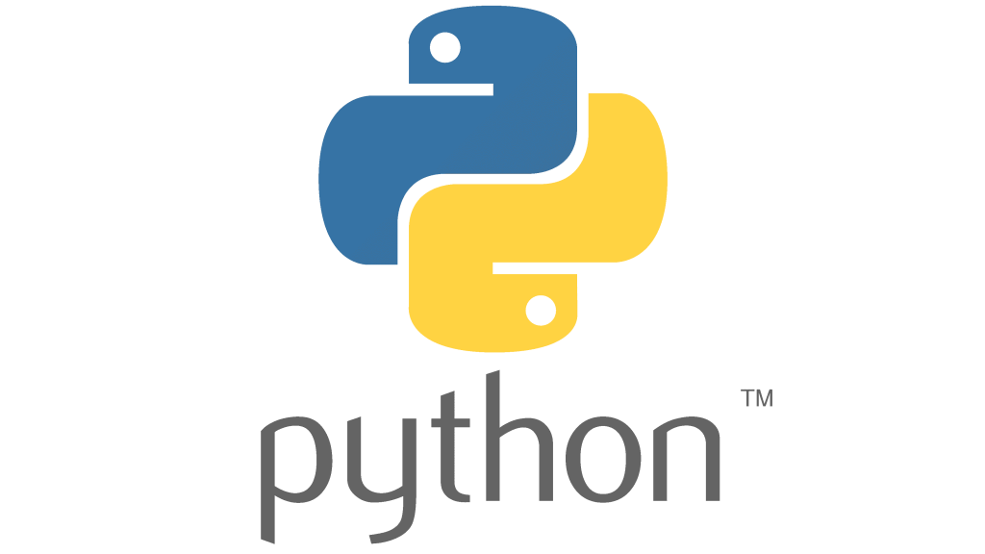
Technology
Azure OpenAI Service
Notes:
AZURE_OPENAI_API_KEY= "3dc10a6d96cc4f6c8a3d52d772534dbf" # Azure OpenAI API Key
AZURE_OPENAI_MODEL_VERSION = "2023-03-15-preview" # Deployed Model Version
AZURE_ENDPOINT = "https://ai-for-python-dev.openai.azure.com/" # Deployed Model Endpoint
AZURE_OPENAI_MODEL_DEPLOYMENT = "gpt-35-turbo" # Deployed Model Name

Slide 19
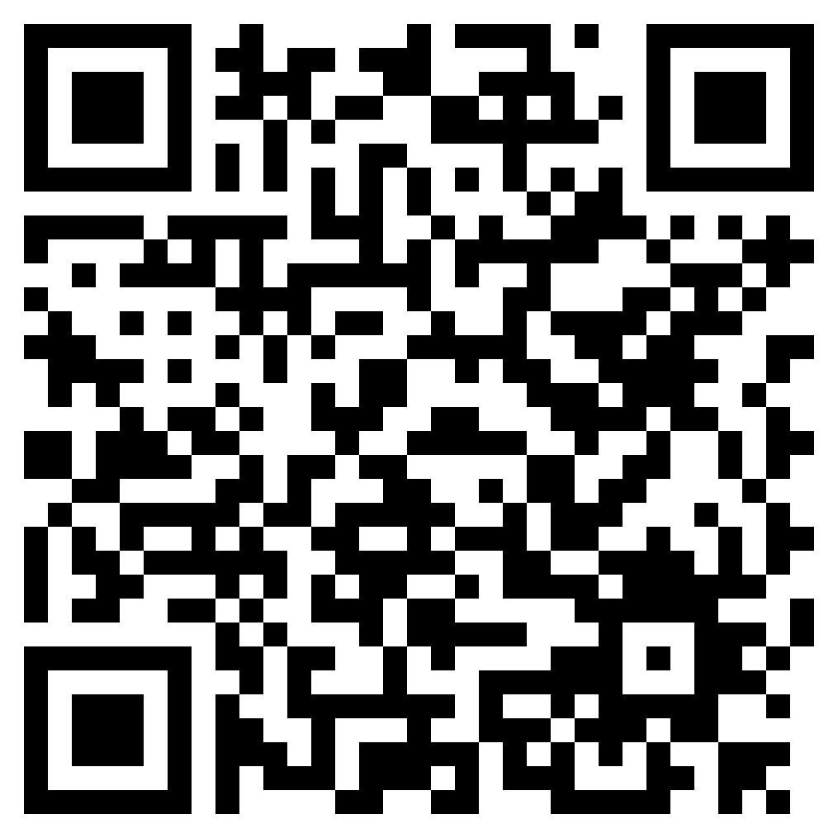
GITHUB
https://github.com/kanin-kearpimy/generative-ai-for-python-developer

Slide 20
Azure OpenAI Service
Notes:
Demo script option #1
Create a new console app in VS (or VS Code)
Add the Azure.AI.OpenAI SDK
Create an app that uses the static prompt such as "What is the latest .NET release and what are the top three features"
Run the completion with streaming to Console.Write
Run app, edit the app to add a small delay between each token update, rerun
For part two, add a system message that includes some info on the .NET 8 release, and rerun to show how you can use System Prompt to ground the data
Demo script option #2
Use the LINQPad file 01-chat
Use the LINQPad file 02-system-message for grounded knowledge
Objective
Show the most basic example of how you use the SDK to do a completion and get a result back.
Highlight that there is a knowledge gap (it doesn't know about .NET 8), so use the system message to update with knowledge on that and rerun.

Slide 21
Azure OpenAI Service
Azure OpenAI Service
Key
API Endpoint
Deployed Model
Model 1
(gpt-4o)
…..
Model N
(text-embedding)
version

Slide 22
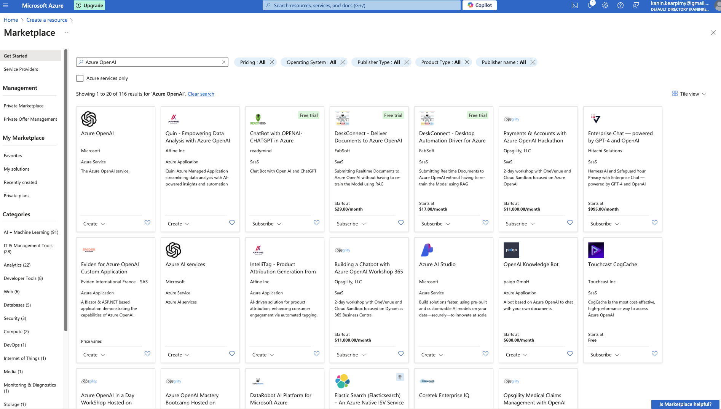
Azure OpenAI Service

Slide 23
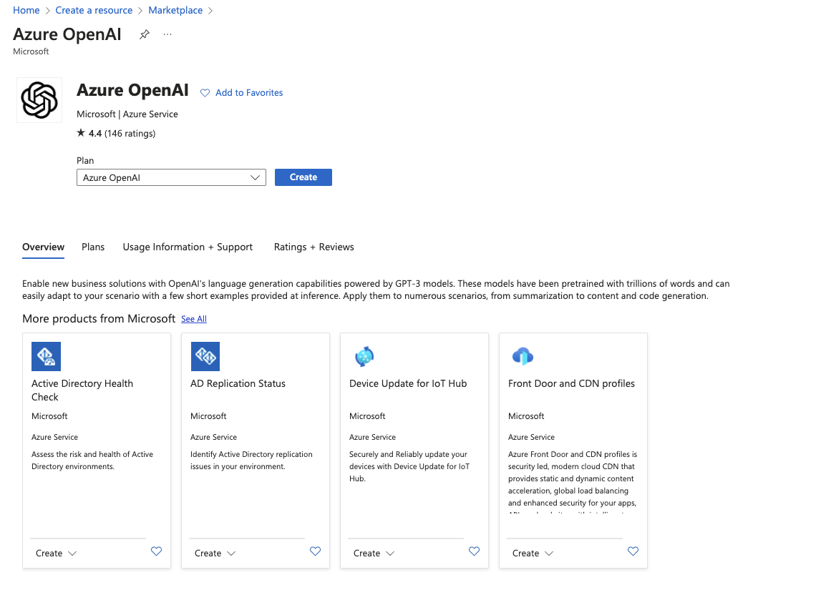
Azure OpenAI Service

Slide 24
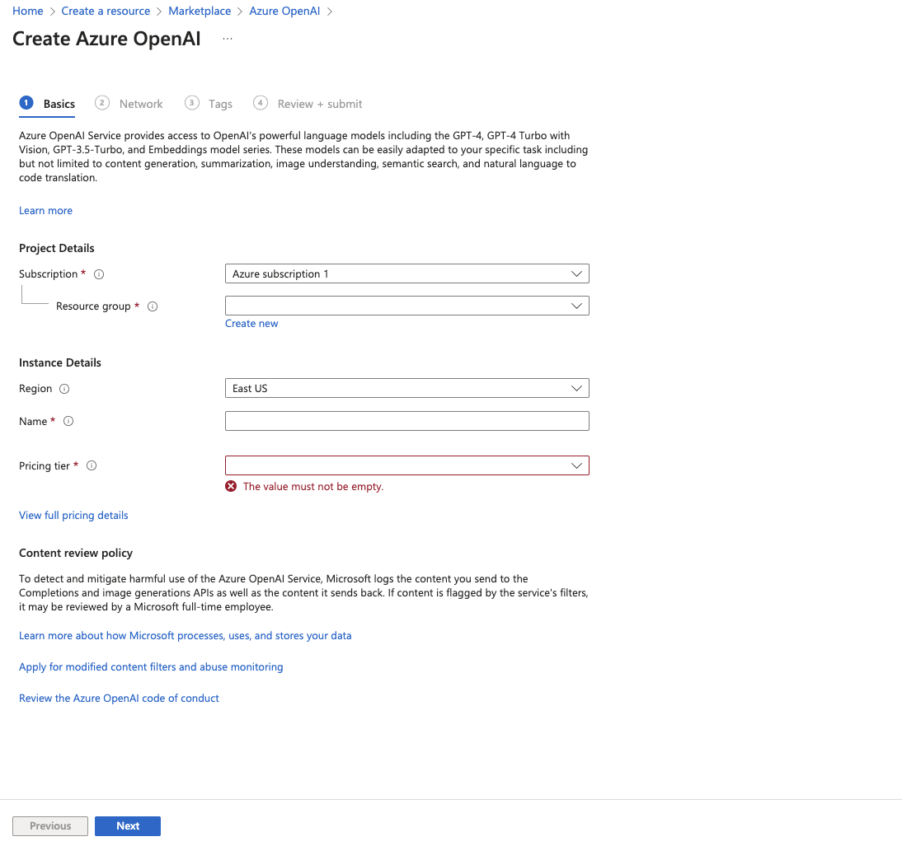
Azure OpenAI Service

Slide 25
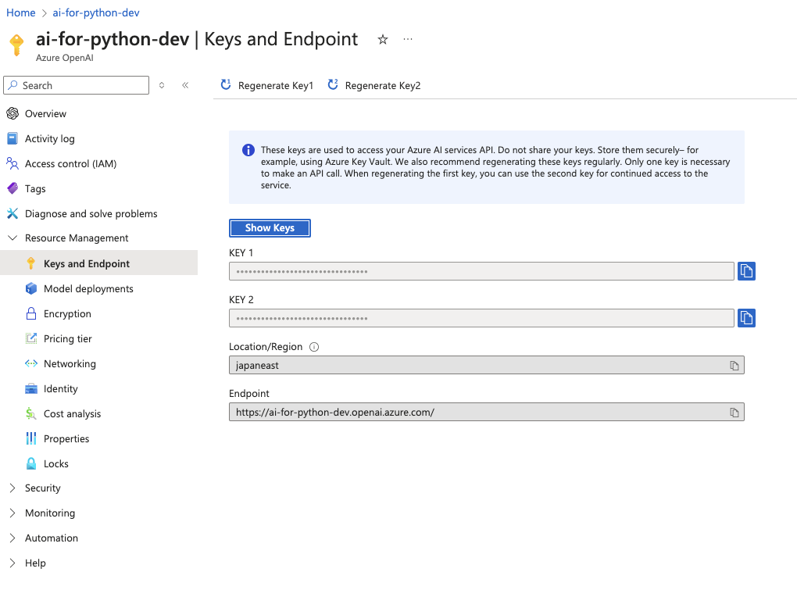
In your resource group
Azure OpenAI Service

Slide 26
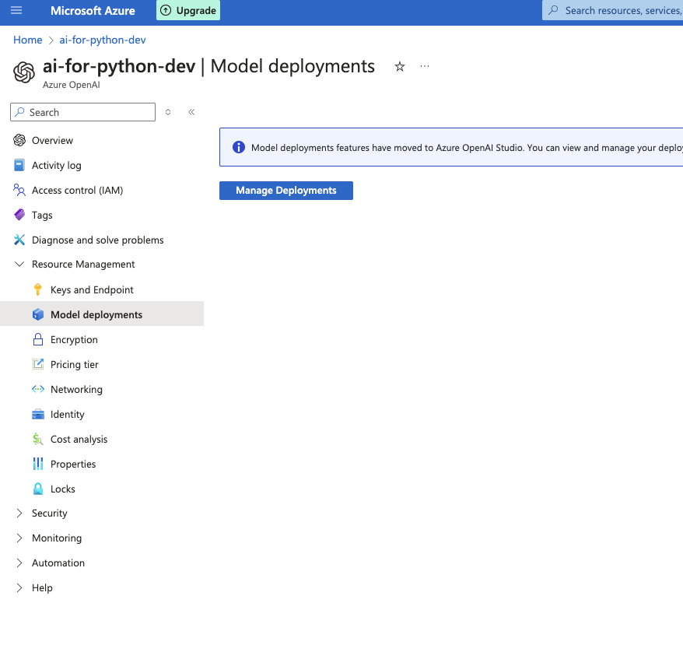
In your resource group
Azure OpenAI Service

Slide 27
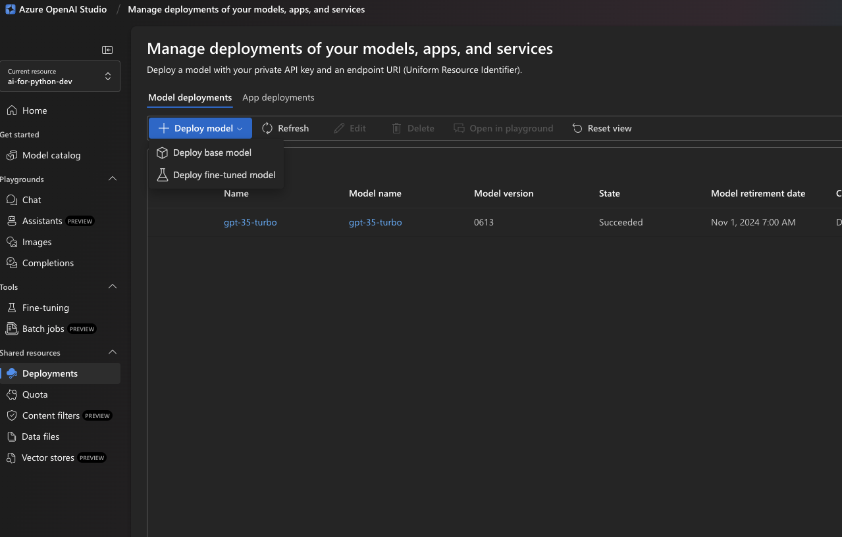
Azure OpenAI Service

Slide 28
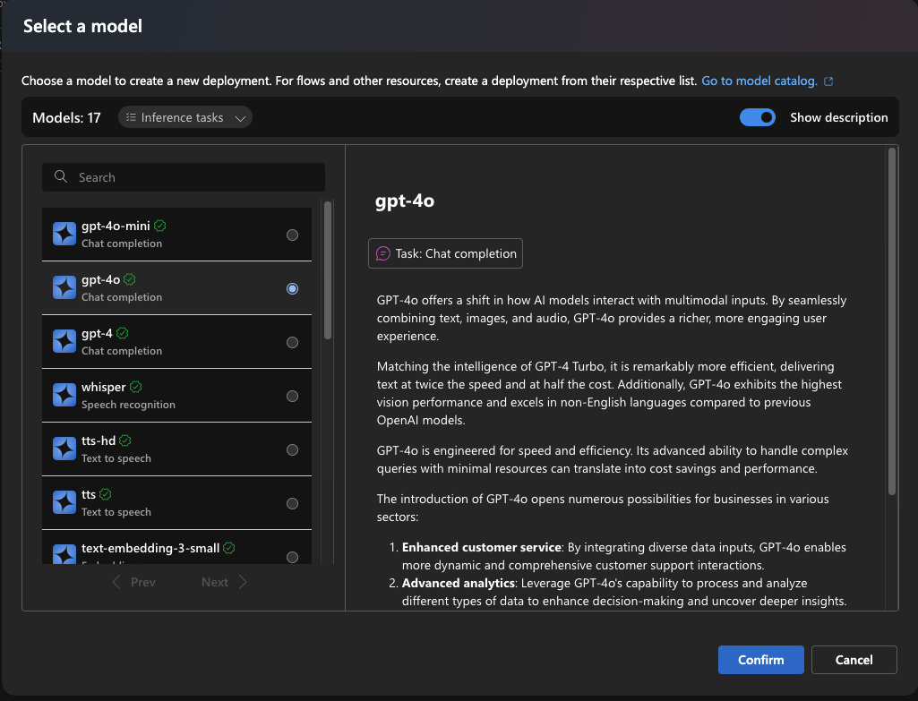
Azure OpenAI Service

Slide 29
Demo – Generating Text
Notes:
Demo script option #1
Create a new console app in VS (or VS Code)
Add the Azure.AI.OpenAI SDK
Create an app that uses the static prompt such as "What is the latest .NET release and what are the top three features"
Run the completion with streaming to Console.Write
Run app, edit the app to add a small delay between each token update, rerun
For part two, add a system message that includes some info on the .NET 8 release, and rerun to show how you can use System Prompt to ground the data
Demo script option #2
Use the LINQPad file 01-chat
Use the LINQPad file 02-system-message for grounded knowledge
Objective
Show the most basic example of how you use the SDK to do a completion and get a result back.
Highlight that there is a knowledge gap (it doesn't know about .NET 8), so use the system message to update with knowledge on that and rerun.

Slide 30
Talking in numbers

Slide 31
GenAI Features: Embeddings
[-0.006655829958617687, 0.0026128944009542465, 0.008792596869170666, -0.02446001023054123, -0.008540431968867779, 0.022071078419685364, -0.010703742504119873, 0.003311325330287218, -0.011632772162556648, -0.02187200076878071, ...]
“Today we are going to learn about Azure AI Studio”
Text Embedding Ada
Notes:
Computers ultimately speak numbers and need to convert text to into a numerical form to understand relationships between words and concepts.
Embedding models transform text into an array of numbers which is the representation of the original text into the semantic space.
The OpenAI ADA model is a large multimodal model, commonly abbreviated as LMM, that can understand both text and images.
It can generate embeddings or vectors of numbers, to encode both the meaning and context of your input prompt.
For example, ADA will take your prompt “Today we are going to learn about Azure AI Studio” and generates a length 10 numerical vector shown on the screen, which captures the meaning of each of those 10 words and concepts like “today” and “Azure AI Studio”.
This is useful for tasks such as semantic search and sentence similarity.

Slide 32
Large Language Model
Natural Language Processing
Text
………………………………………………………………
Vectorization
embedding
LLM
backbone
1010101101
Large Language Model (LLM)

Slide 33
Similarity
“Word”
[0.2135, -0.25355]
vector

Slide 34
Executing custom logic

Slide 35
Azure OpenAI Function Calling
Meta Prompt
Prompt
Prompt
Response
You're an AI assistant designed to help users search for hotels. When a user asks for help finding a hotel, you should call the search_hotels function.
Function
{
"name": "search_hotels",
"description": "Retrieves hotels from the search index based",
"parameters": {
"type": "object", "properties": {
"location": { "type": "string",
"description": "The location of the hotel (i.e. Seattle, WA)"
},
”max_price": { "type": ”number",
"description": "The maximum price for the hotel"
},
},
"required": ["location","max_price"]
}
}
Hotel with a private beach cost max 300 euro in Delmaris.
{ "location":"Delmaris", "max_price": 300, }
Notes:
The latest versions of gpt-35-turbo and gpt-4 are fine-tuned to work with functions and are able to both determine when and how a function should be called. If one or more functions are included in your request, the model determines if any of the functions should be called based on the context of the prompt. When the model determines that a function should be called, it responds with a JSON object including the arguments for the function.
So, in this example, we specify in the system prompt that we want to call the search_hotels function also shown in this image. When the model is provided a prompt it then responds with a JSON object that includes the arguments for the function call.
Its important to note that although the model can generate the calls it is best for you to execute them to remain in control.

Slide 36
Demo - Functions
Notes:
Python: https://learn.microsoft.com/en-us/azure/ai-services/openai/how-to/function-calling
Demo Script
Open the LINQPad file 03-functions
Walk through the C# function definition
Show the output of the call to the model

Slide 37
Model Knowledge

Slide 38
The knowledge gap
Training data (up to)
Prompt
GPT4 gpt-4-32k(0613) September 2021
gpt-4 (1106-preview) April 2023
GPT3.5 gpt-35-turbo (0613) gpt-35-turbo (1106) September 2021
User prompt
Is Queen Elizabeth II still alive?
Assistant
As of my last update, Queen Elizabeth II is still alive. However, please note that my information might not be up to date, so I recommend verifying it with a reliable source.
Notes:
If you ask a model a fact like: Is Queen Elizabeth II still alive? It might answer: YES! This is because of the knowledge cut off for the training data used Most models have knowledge up to September 2021

Slide 39
Doesn't know my data
User prompt
I need warm waterproof shoes
to go on a hike.
Assistant
Sure! I can help you with that. When it comes to warm and waterproof shoes for hiking, there are a few options available. Here are some popular brands and models to consider:
Salomon X Ultra Winter CS WP: These shoes are designed for winter hiking and feature waterproof protection, insulation, and a supportive outsole.
Notes:
These models are aware of a large amount of information but that information is generic in design, sure, it can tell you a summary of a movie but it doesn’t know anything about your business and your business data.
Let’s take a user prompt like we have on screen. Here the user is wanting something specific about what might be a good hiking shoe.
The kind of response we’re hoping for we can see now, but how would it know about that, which is inside our organization

Slide 40
Adding knowledge to the prompt
Meta Prompt
Prompt
Prompt
Response
## Task
You are an AI agent for the Contoso Trek outdoor products retailer. As the agent, you answer questions briefly, succinctly, and in a personable manner using markdown and even add some personal flair with appropriate emojis.
Sure, I'd be happy to help! 😊 Based on the available documentation, I can recommend two choices from the Contoso Trek catalog.
Product: TrailWalker Hiking Shoes ID: 36244753 Brand: TrekReady […]
I need warm waterproof shoes
to go on a hike.
## Documents The following documentation should be used in the response. The response should specifically include the product id.
TrailWalker hiking Shoes
The Adventurer Pro Backpack is designed to provide comfort, durability, and ample storage space for your outdoor adventures. Familiarize yourself with the key features of the backpack […]
TrekHiker Walking Booths The Adventurer Pro Backpack is designed to provide comfort, durability, and ample storage space for your outdoor adventures. Familiarize yourself with the key features of the backpack […]
Notes:
We can add new knowledge in our system prompt
- Specifying the task - Adding the documents / new knowledge
- Ask the question and now we get results about our data

Slide 41
Retrieval Augmented Generation
User Question
Workflow
Query My Data
Retriever over Knowledge Base
Add Results to Prompt
Query Model
Large Language Model
Send Results
Notes:
Adding knowledge that we retrieve from data source into the prompt we call "Retrieval Augmented Generation"
Retrieval-augmented generation (RAG) allows for incorporating data directly into prompts without retraining models.
RAG is efficient and cost-effective due to its relatively quick process and inexpensive indexing.
Internal tests show that RAG is effective at adding knowledge to AI experiences.
Both RAG and fine-tuning are complementary technologies, not mutually exclusive.

Slide 42
Walkthrough the code
Notes:
Now that we understand about how the different aspects of Generative AI work and how we can use Azure OpenAI Services are our platform for generative AI, let’s return to our demo and learn a bit more about how it works.
Demo Script
Free-form walk through the code that underpins the RAG app that you used as the first demo

Slide 43
System Flow
Azure OpenAI Service
(3) Query Model
LLMs Service
(1) question
Frontend Application
Backend
Application
(4) summary
(2) Query Data
Database

Slide 44
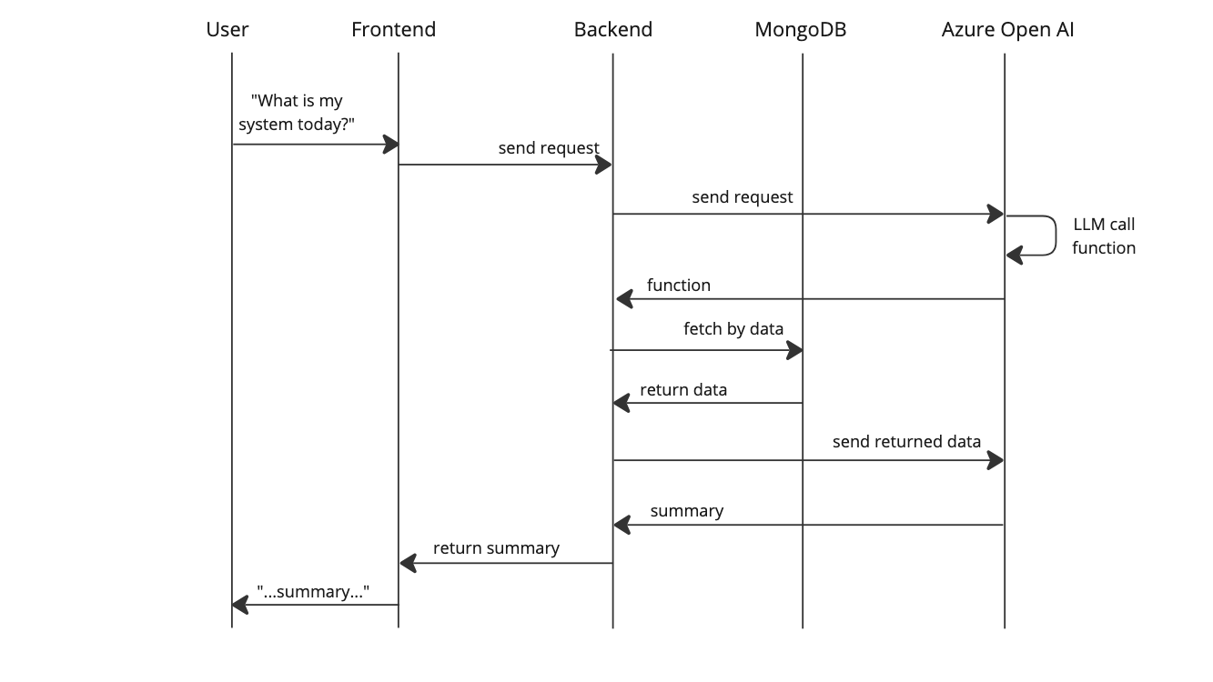
System Flow (Sequence Diagram)

Slide 45
In closing
AI means a lot, but right now it’s mostly Generative AI
Azure OpenAI Service for GPT models
https://github.com/kanin-kearpimy/generative-ai-for-python-developer

Slide 46
Microsoft wants to hear from YOU!
Attendee Survey
Season of AI | Microsoft Community
aka.ms/AttendeeSurveySeasonOfAI
2024
Notes:
Remind attendees to participate in the event survey

Slide 47
Thank you

